Slide 1

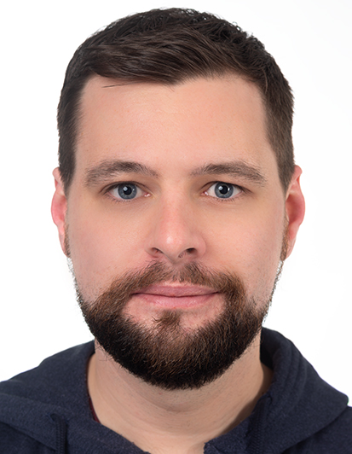
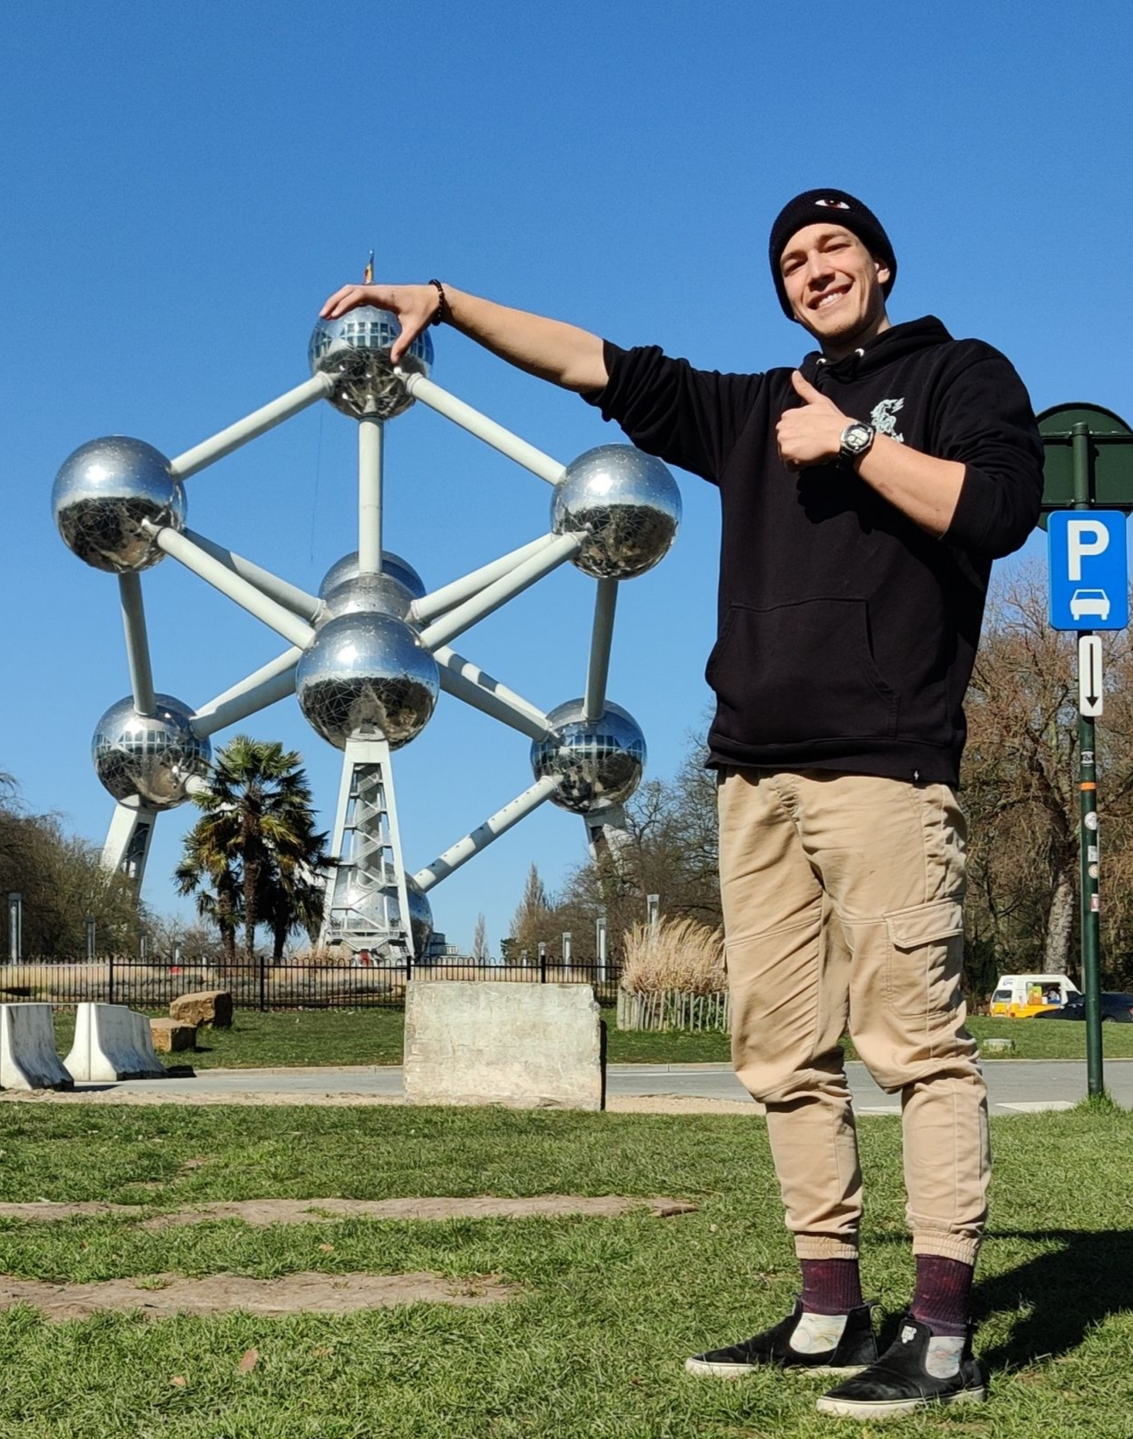
Physical Computing 2022 Group 1
f
Jakob Wietstock
Master 2nd Semester
Cedric Krug
Bachelor 5th Semester
Donatien Leray
Bachelor 5th Semester
1

Slide 2
Overview
Initial Project idea
Protoypes throughout the semester
Final Product
Evaluation
Building
Reflection and Outlook

Slide 3
Project idea
Laser harp, a harp that uses lasers instead of strings
Target group:
  Tech enthusiasts
  People who like quirky instruments

Slide 4
Concept/Requirements
Laser harp
Playable with your hands by disrupting lasers
7 playable basic notes
2 octaves
5 halftones (per octave)
Visual feedback of the location of the lasers
Target Group: Tech enthusiasts,
people who like quirky instruments

Slide 5
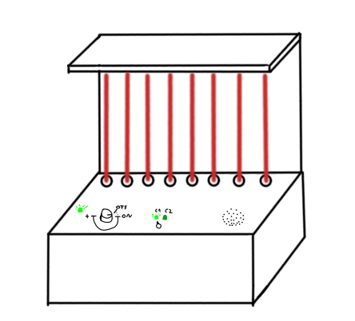
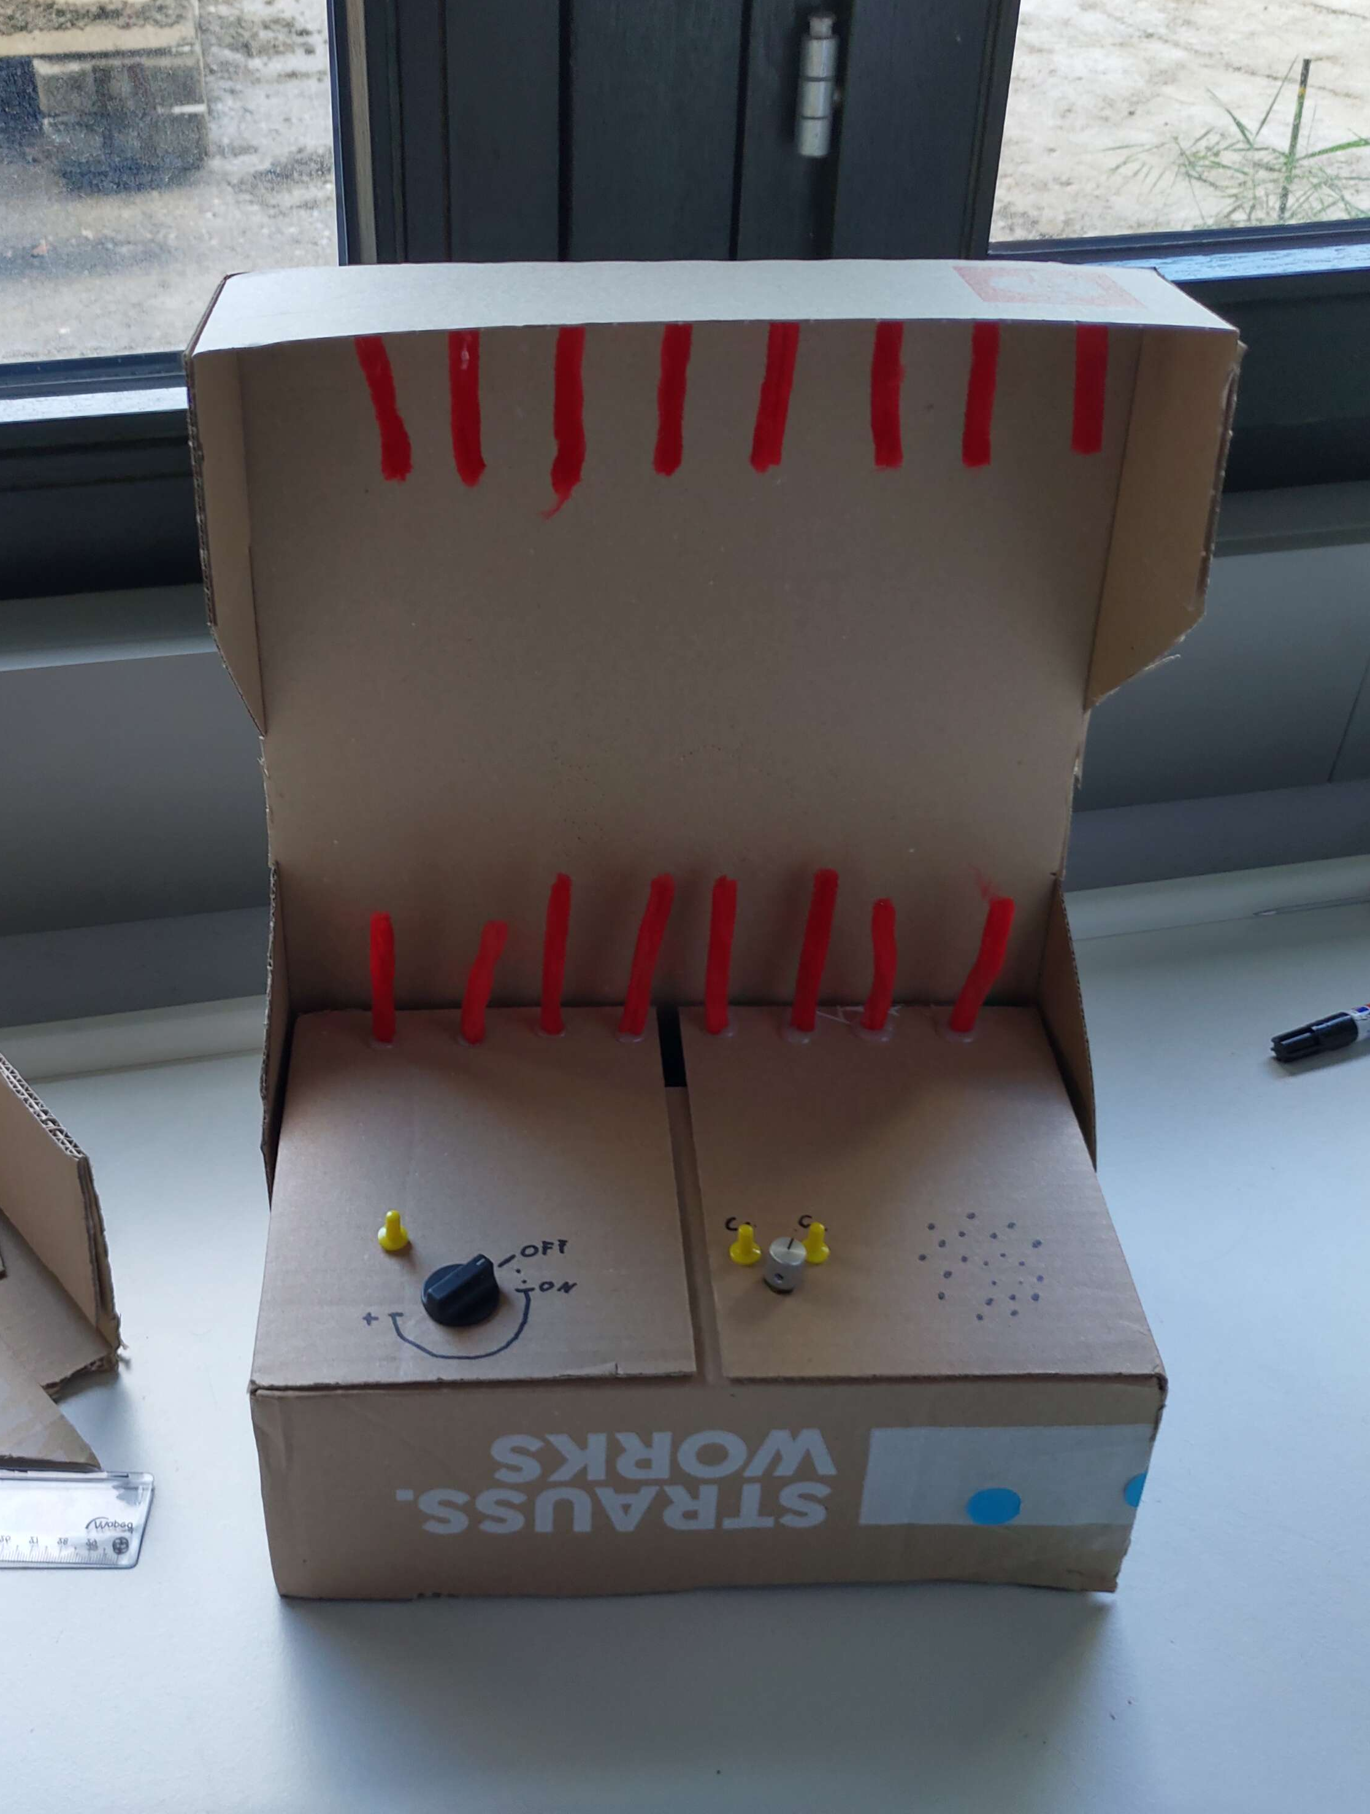
Initial design

Slide 6
Presentation feedback
Labelling the lasers so you know which note is played
Visual feedback for where the lasers are

Slide 7
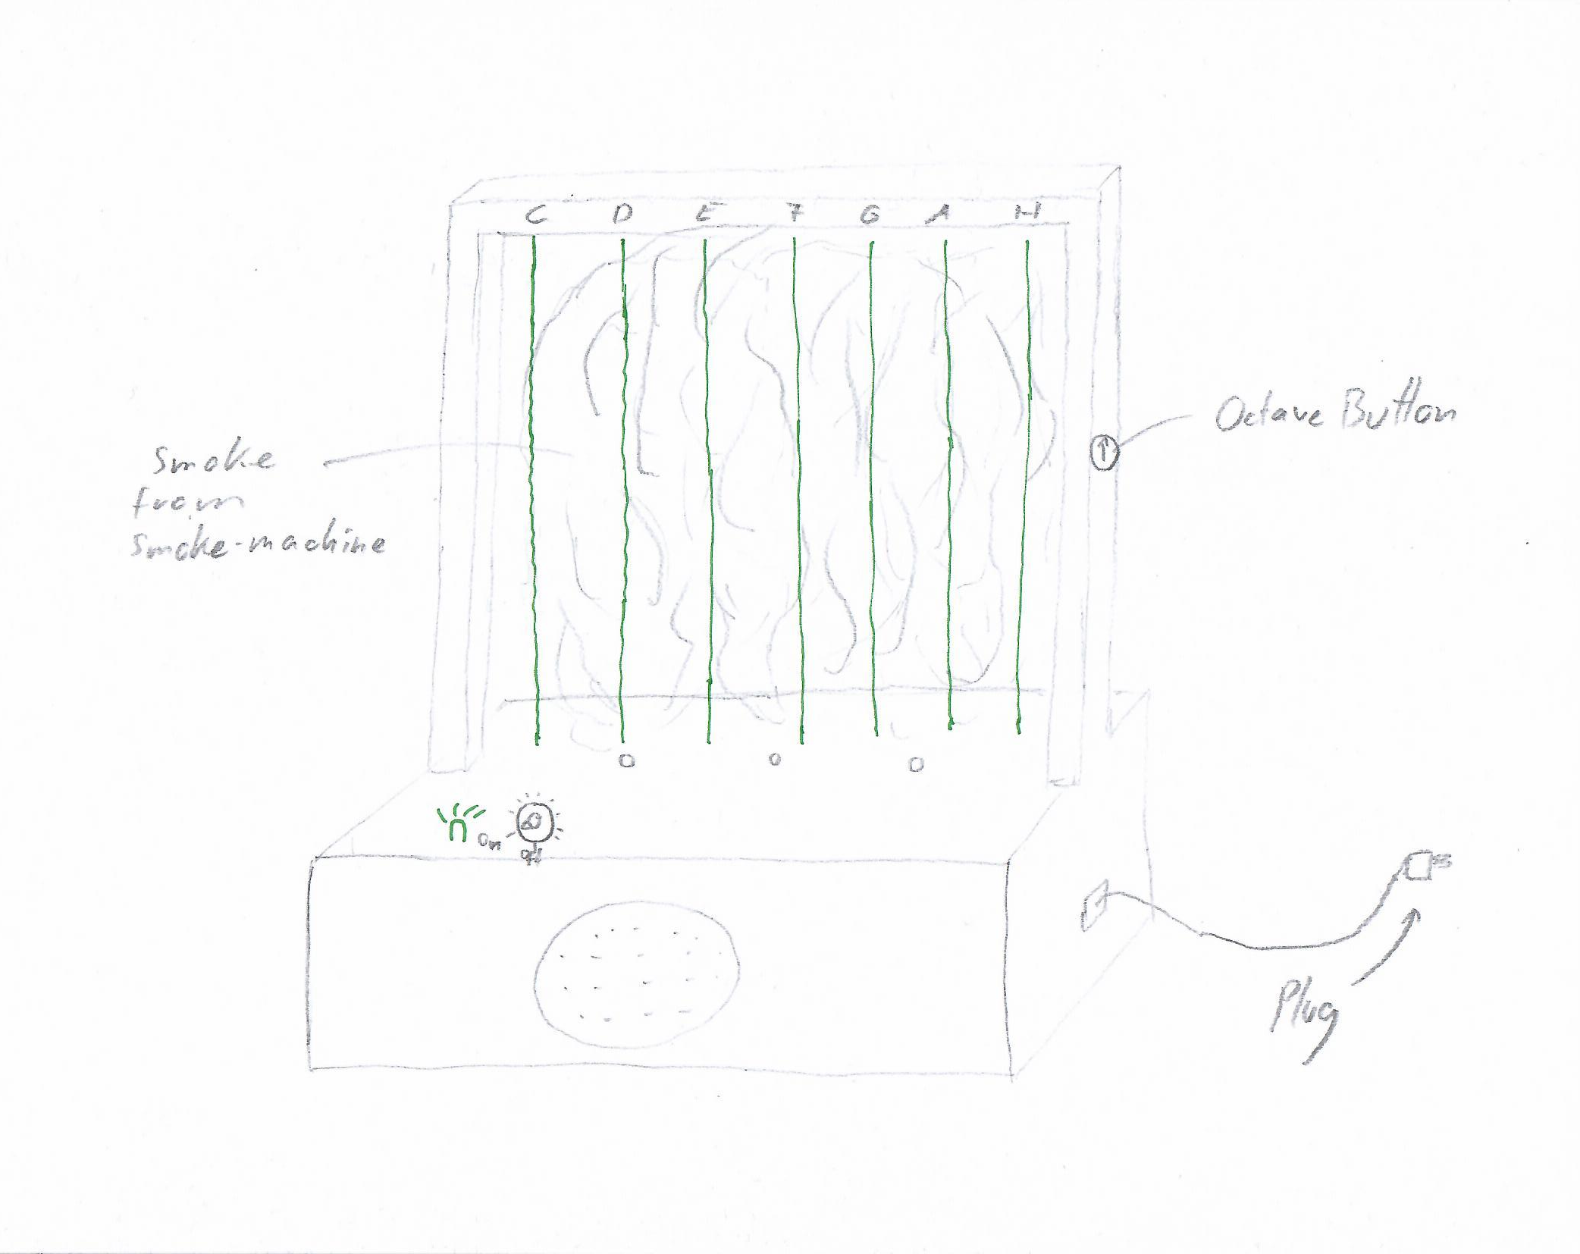
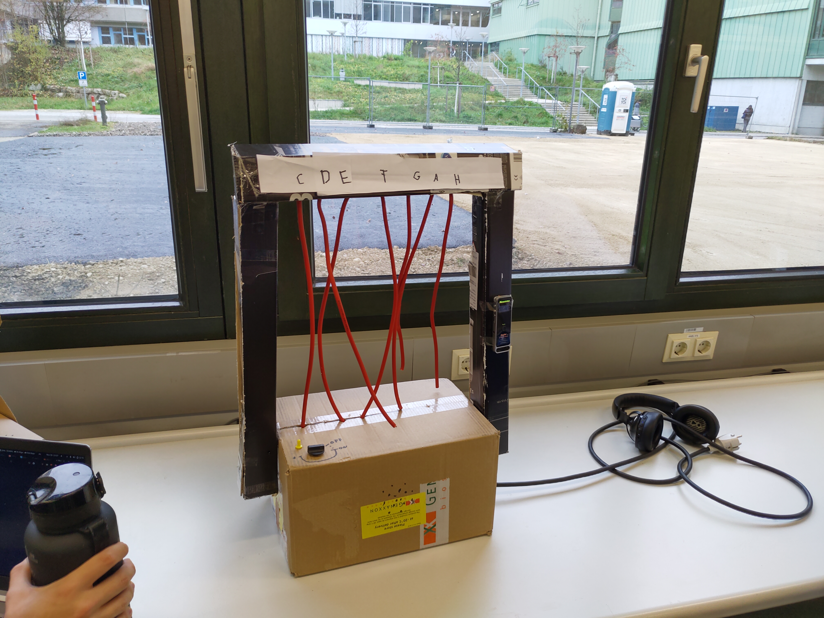
Updated Sketch/Prototype

Slide 8
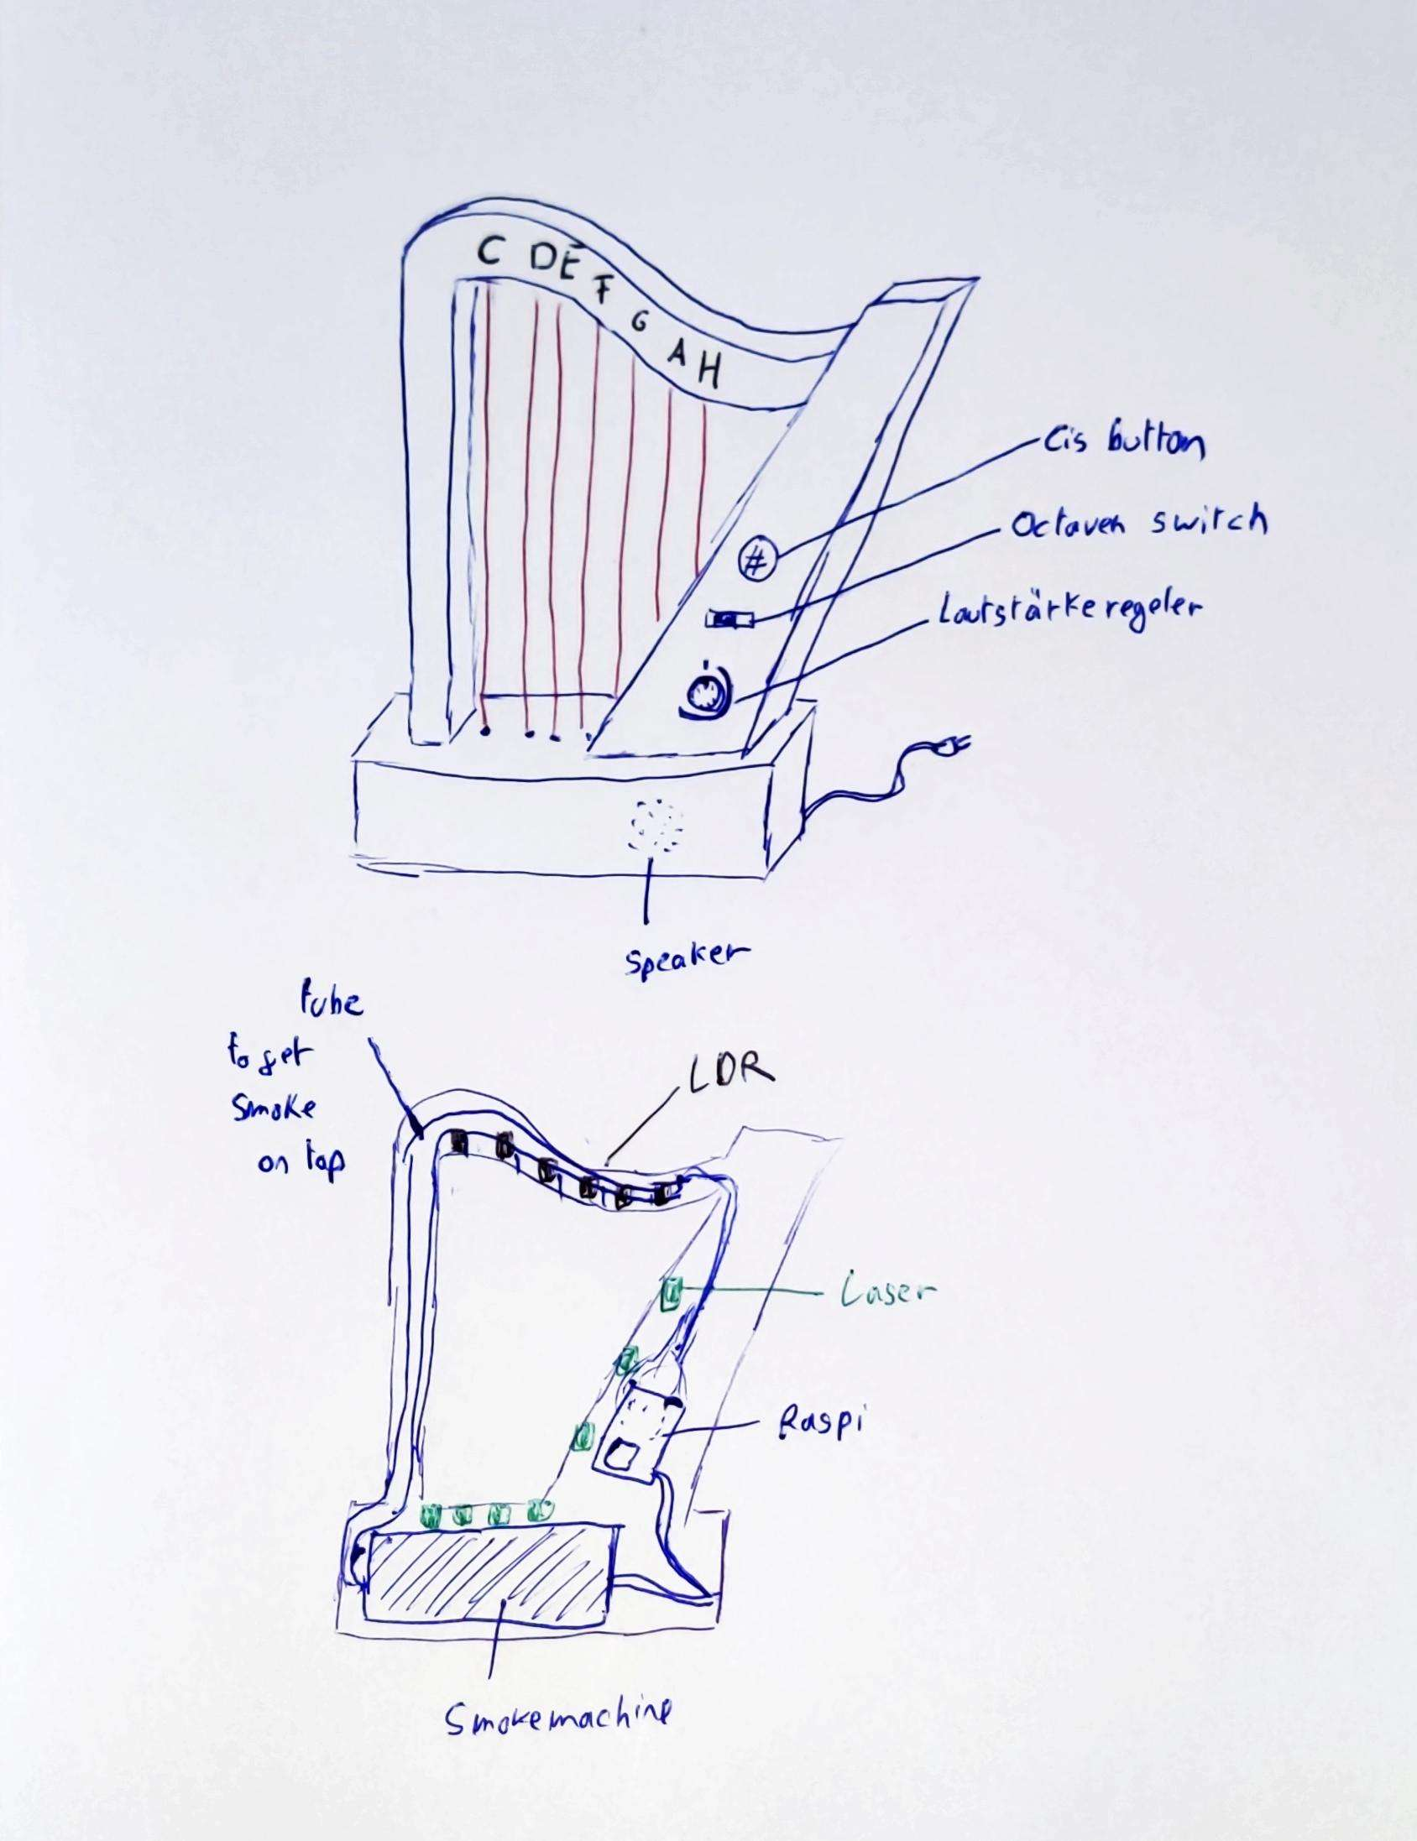
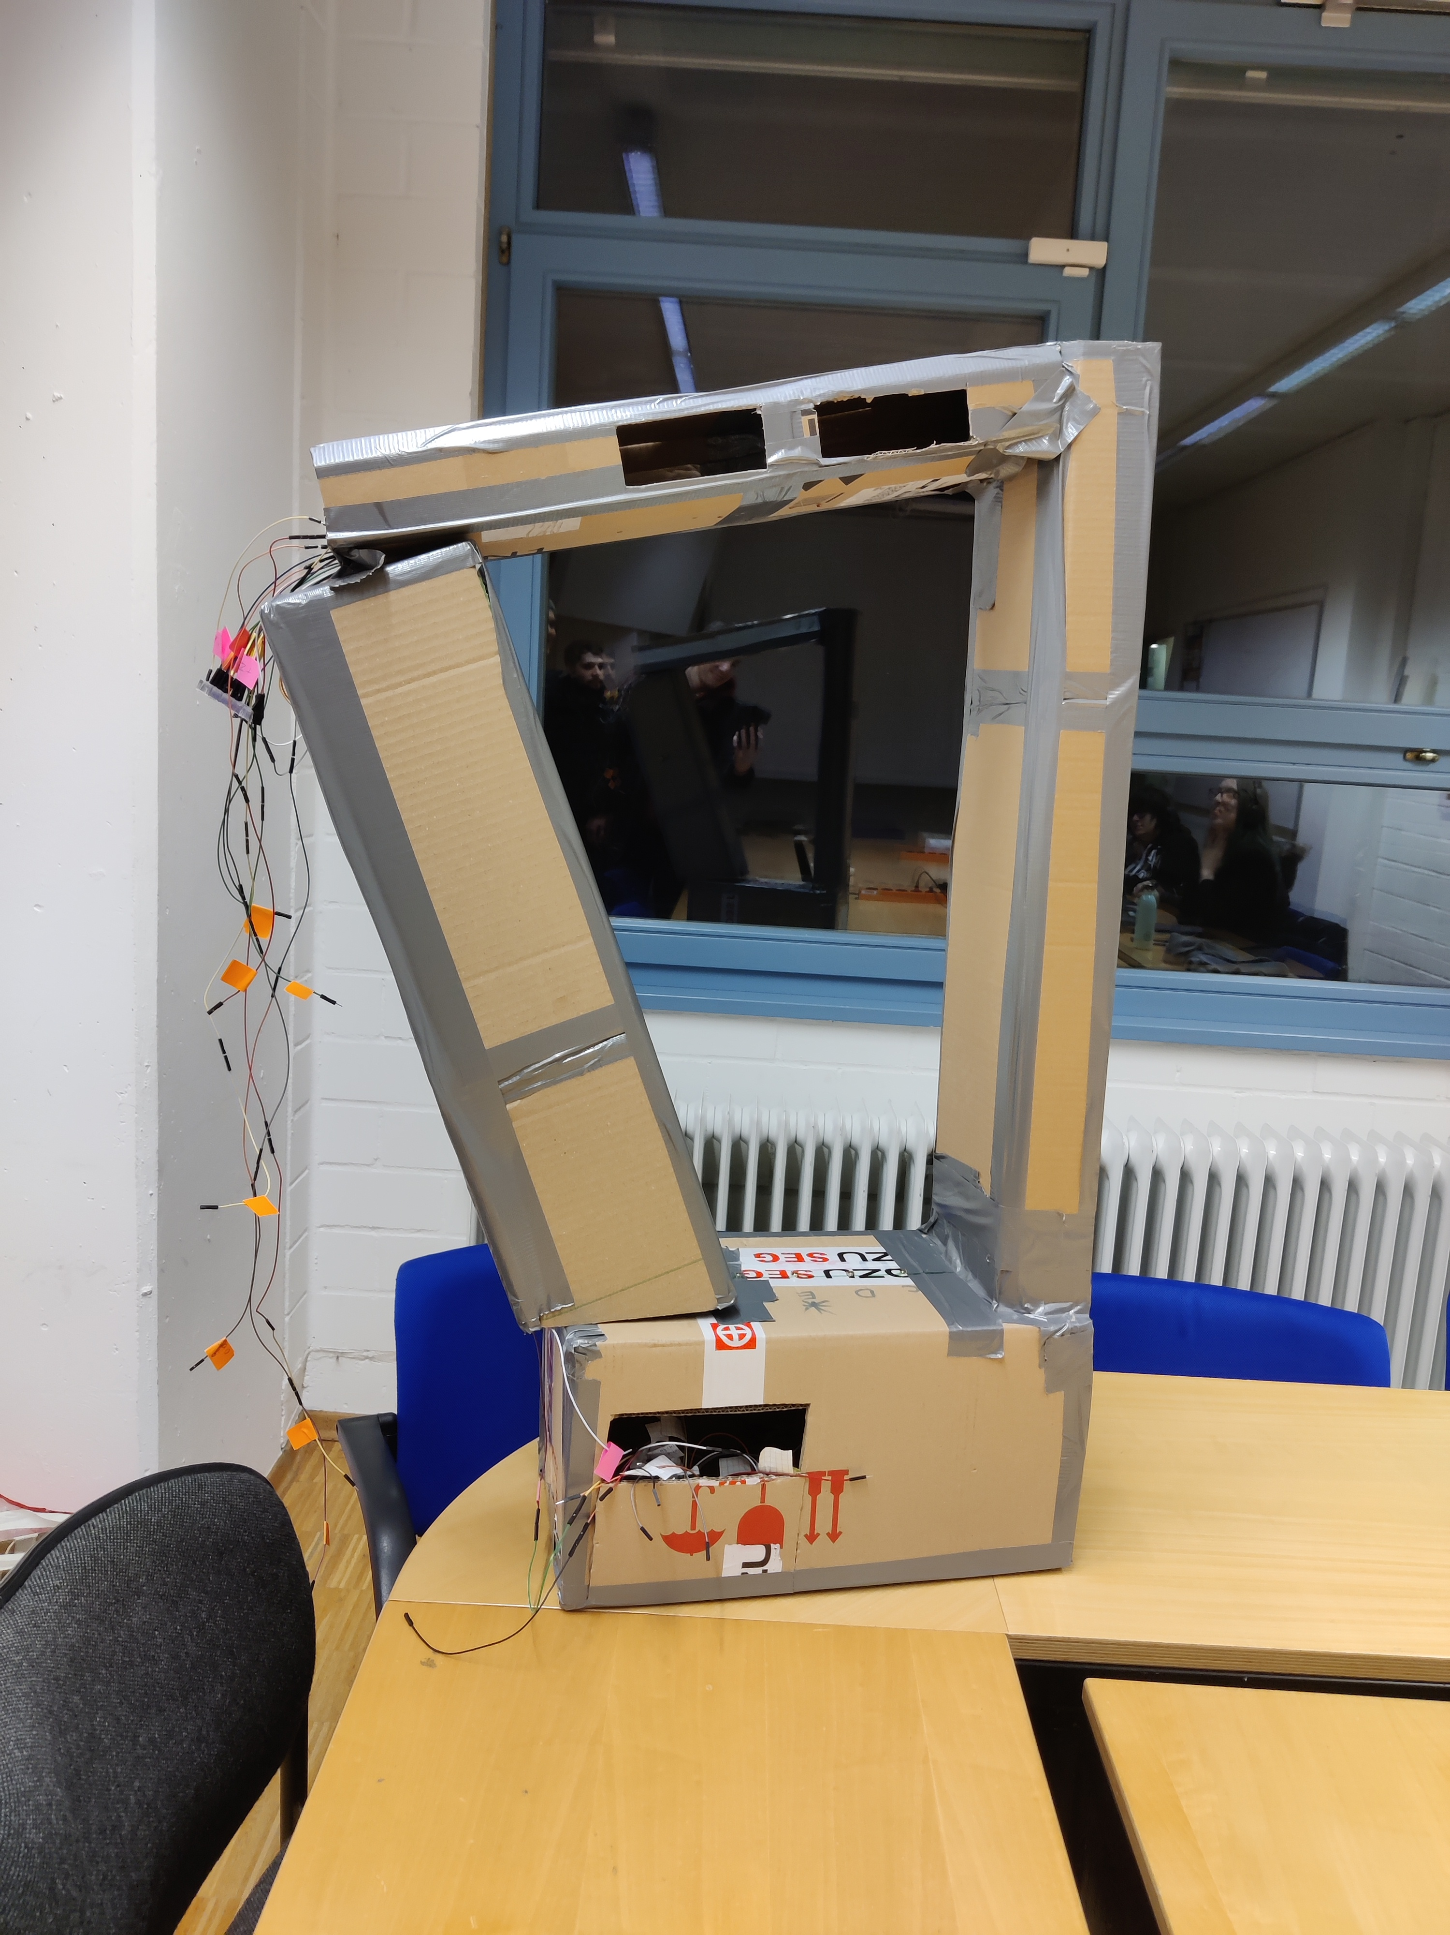
Final design

Slide 9
Final Product vs Initial Design
Completely remodelled frame
Removed On-/Off-button
Added Smoke-machine
Added sharp-button and functionality

Slide 10
Peer evaluation
Select different instruments for the harp to emulate
You should be able to turn off the smoke machine

Slide 11
Informal Peer evaluation
Select different instruments for the harp to emulate
You should be able to turn off the smoke machine

Slide 12
Final evaluation: Plan
Think aloud study with 3 Users
UEQ to evaluat User Experience
Non standardized after test Questionnnaire

Slide 13
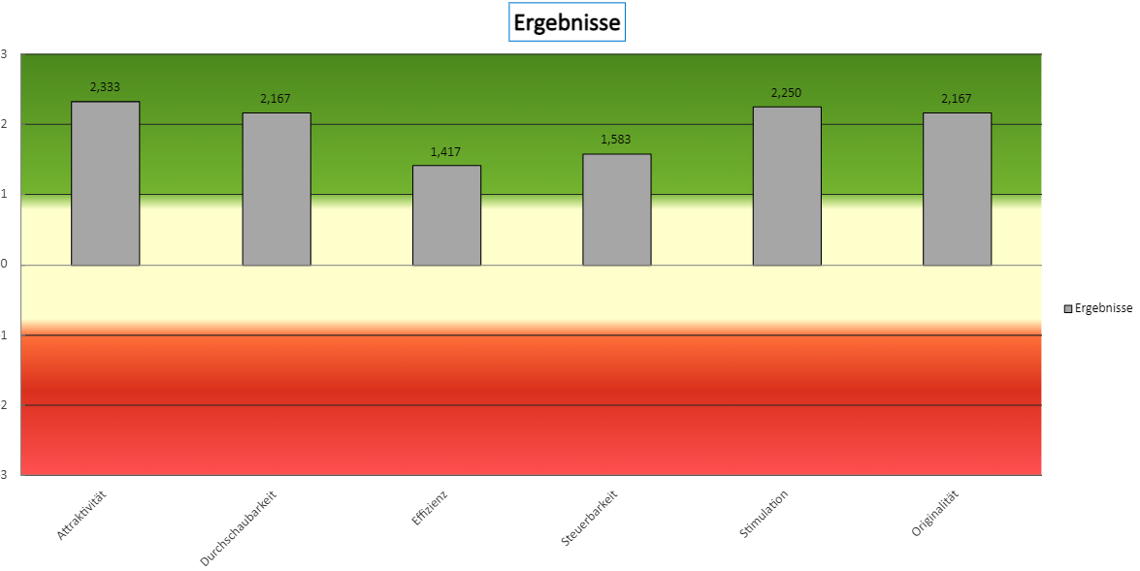
Final evaluation: Results

Slide 14
Final evaluation: Results
Stable Frame necessary so lasers dont miss sensors
Visual feedback important for interaction
Area of lightsensors should be improved
Maybe also a switch for lower halftones

Slide 15
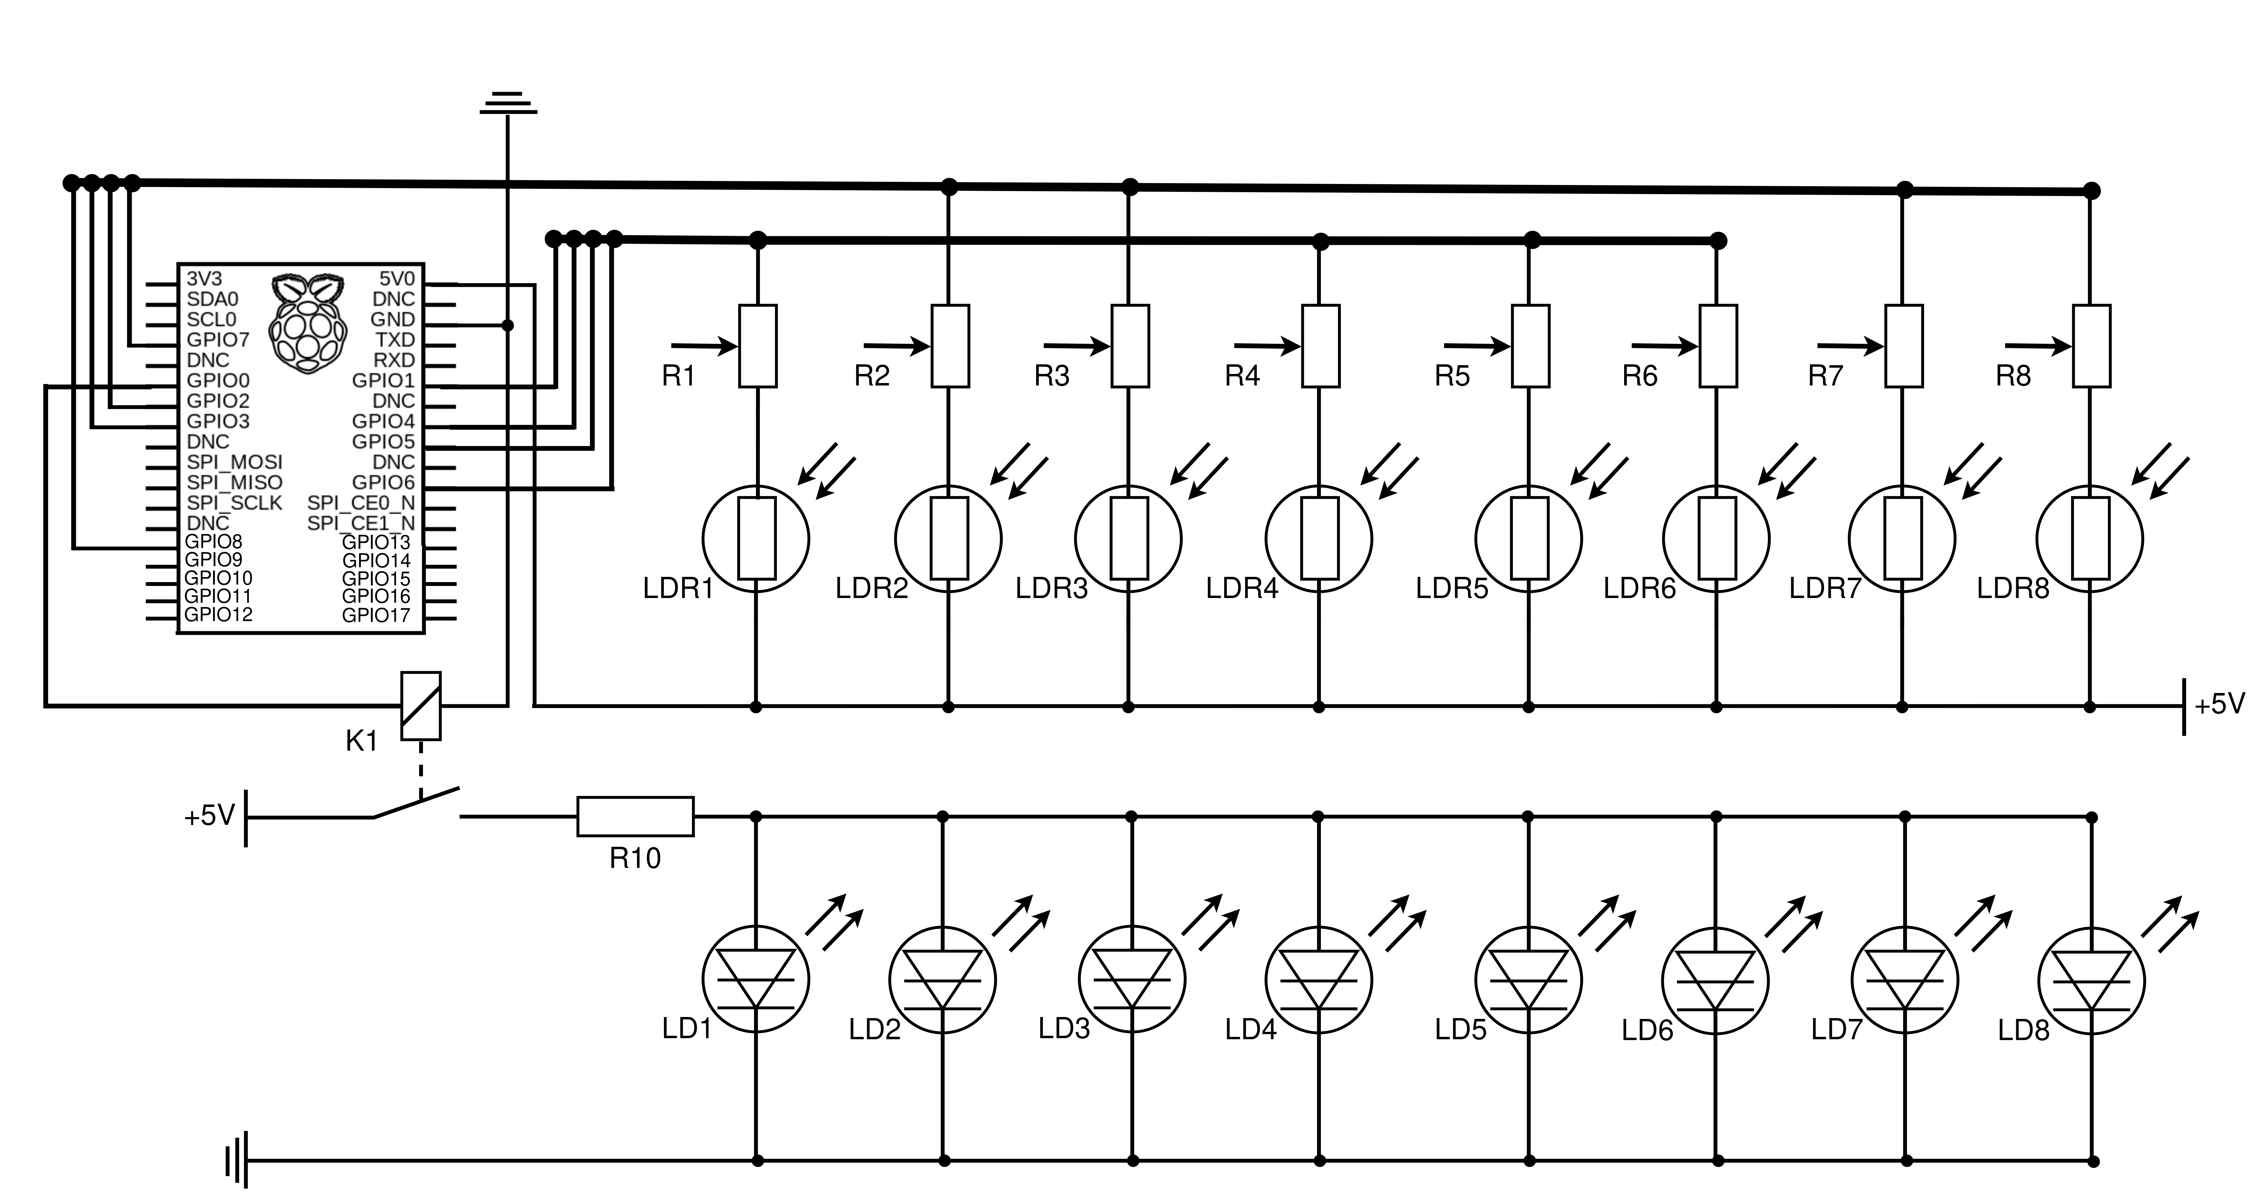
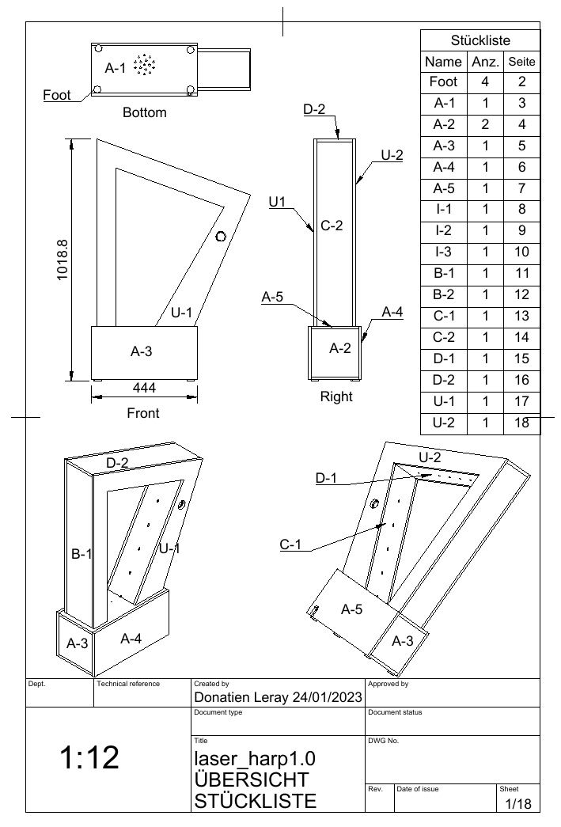
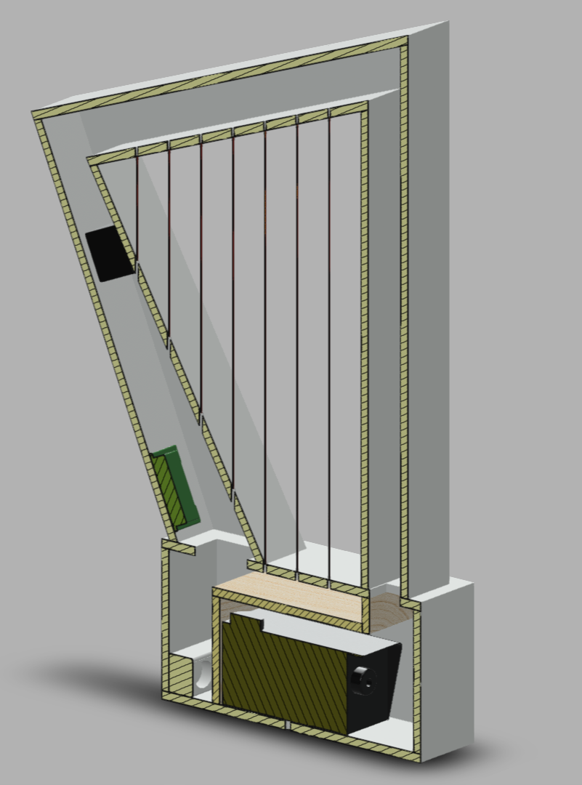
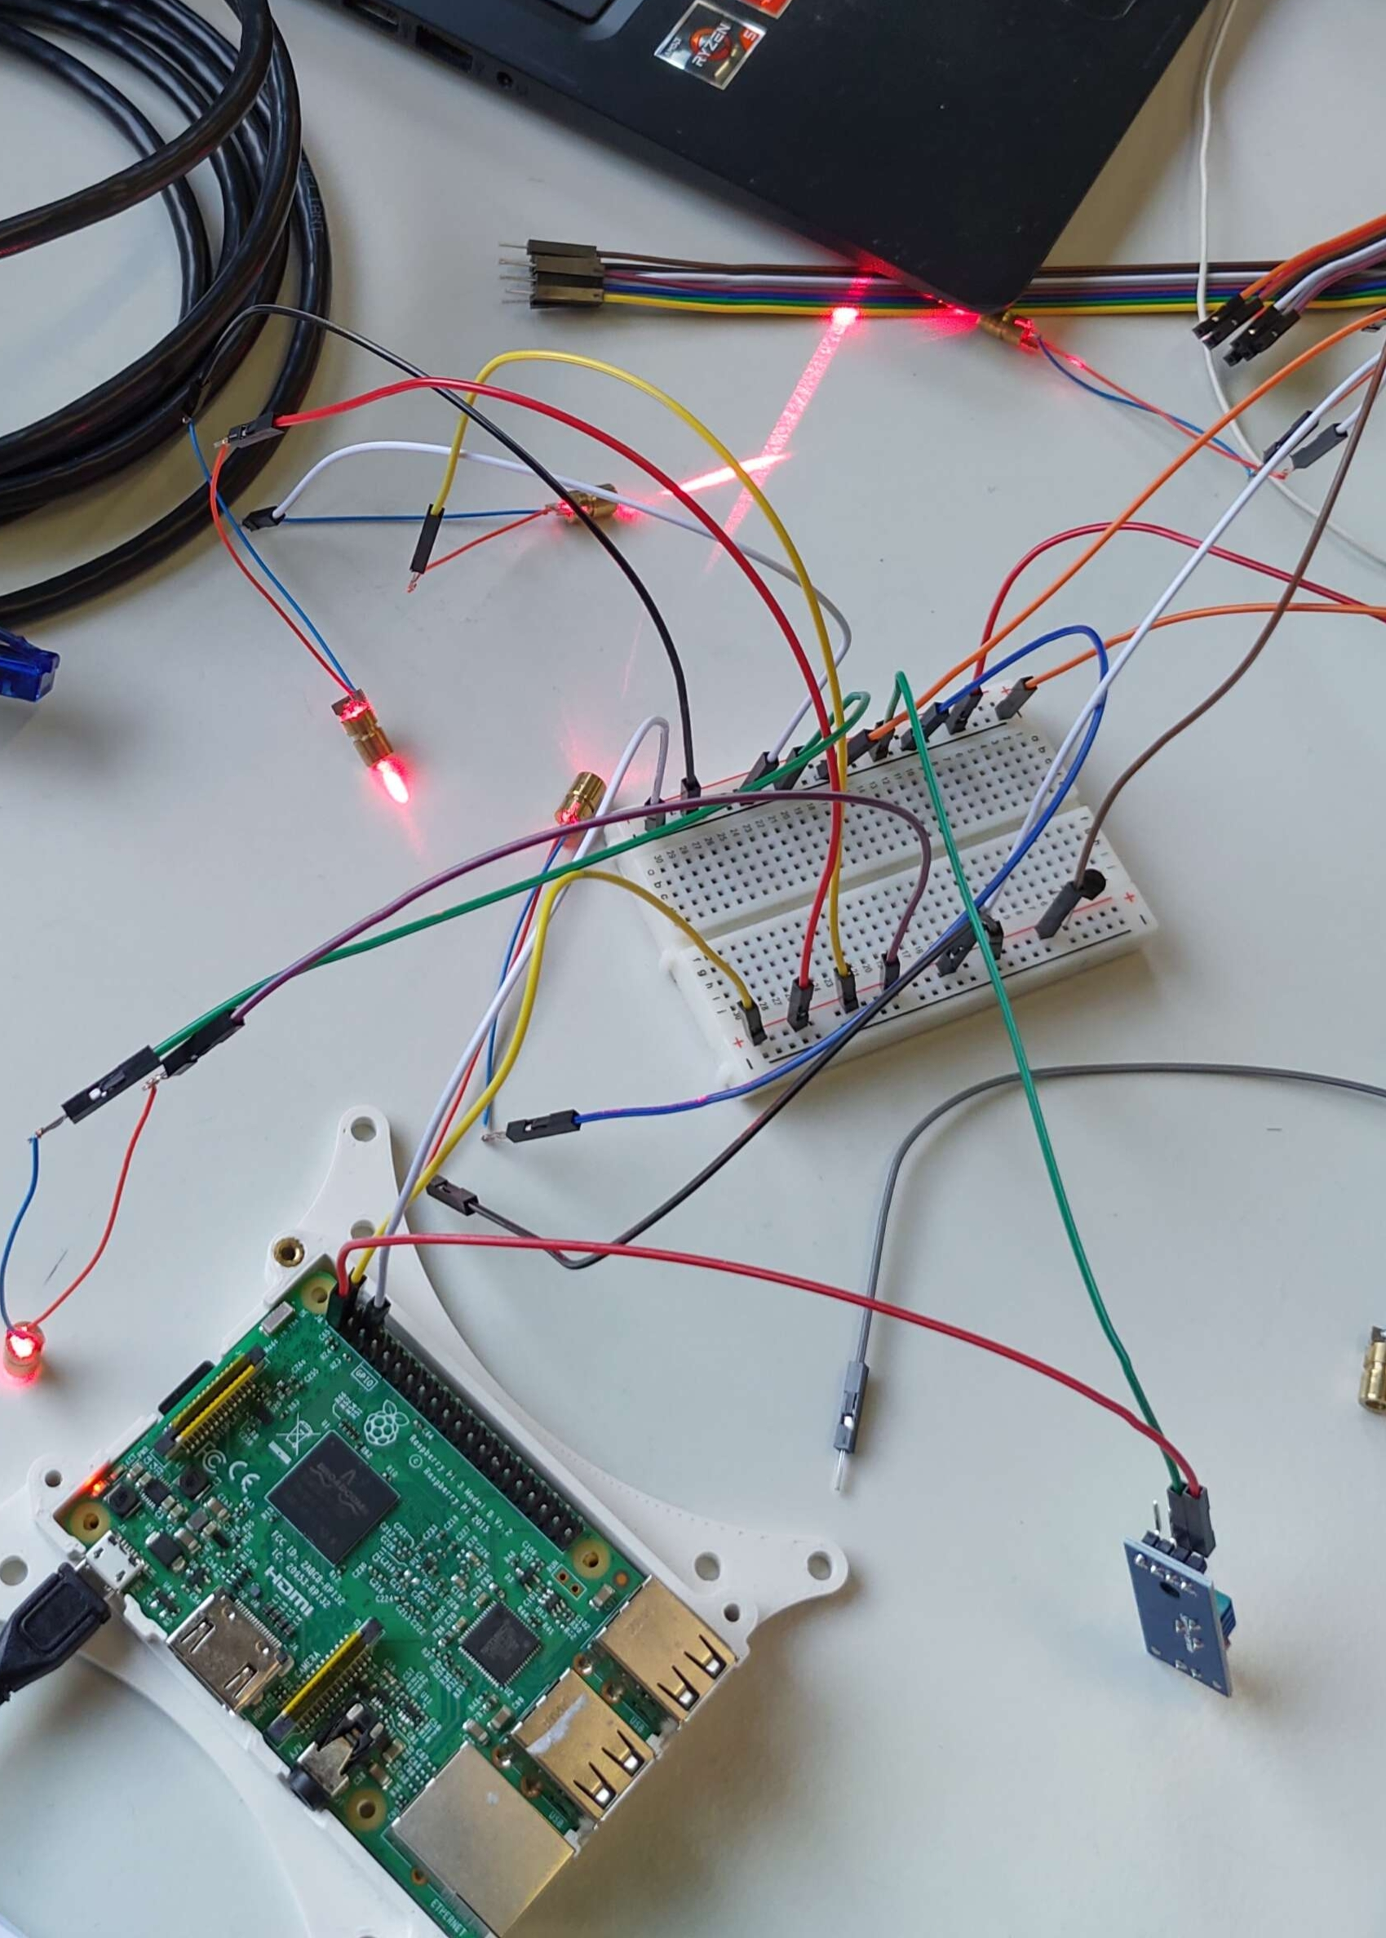
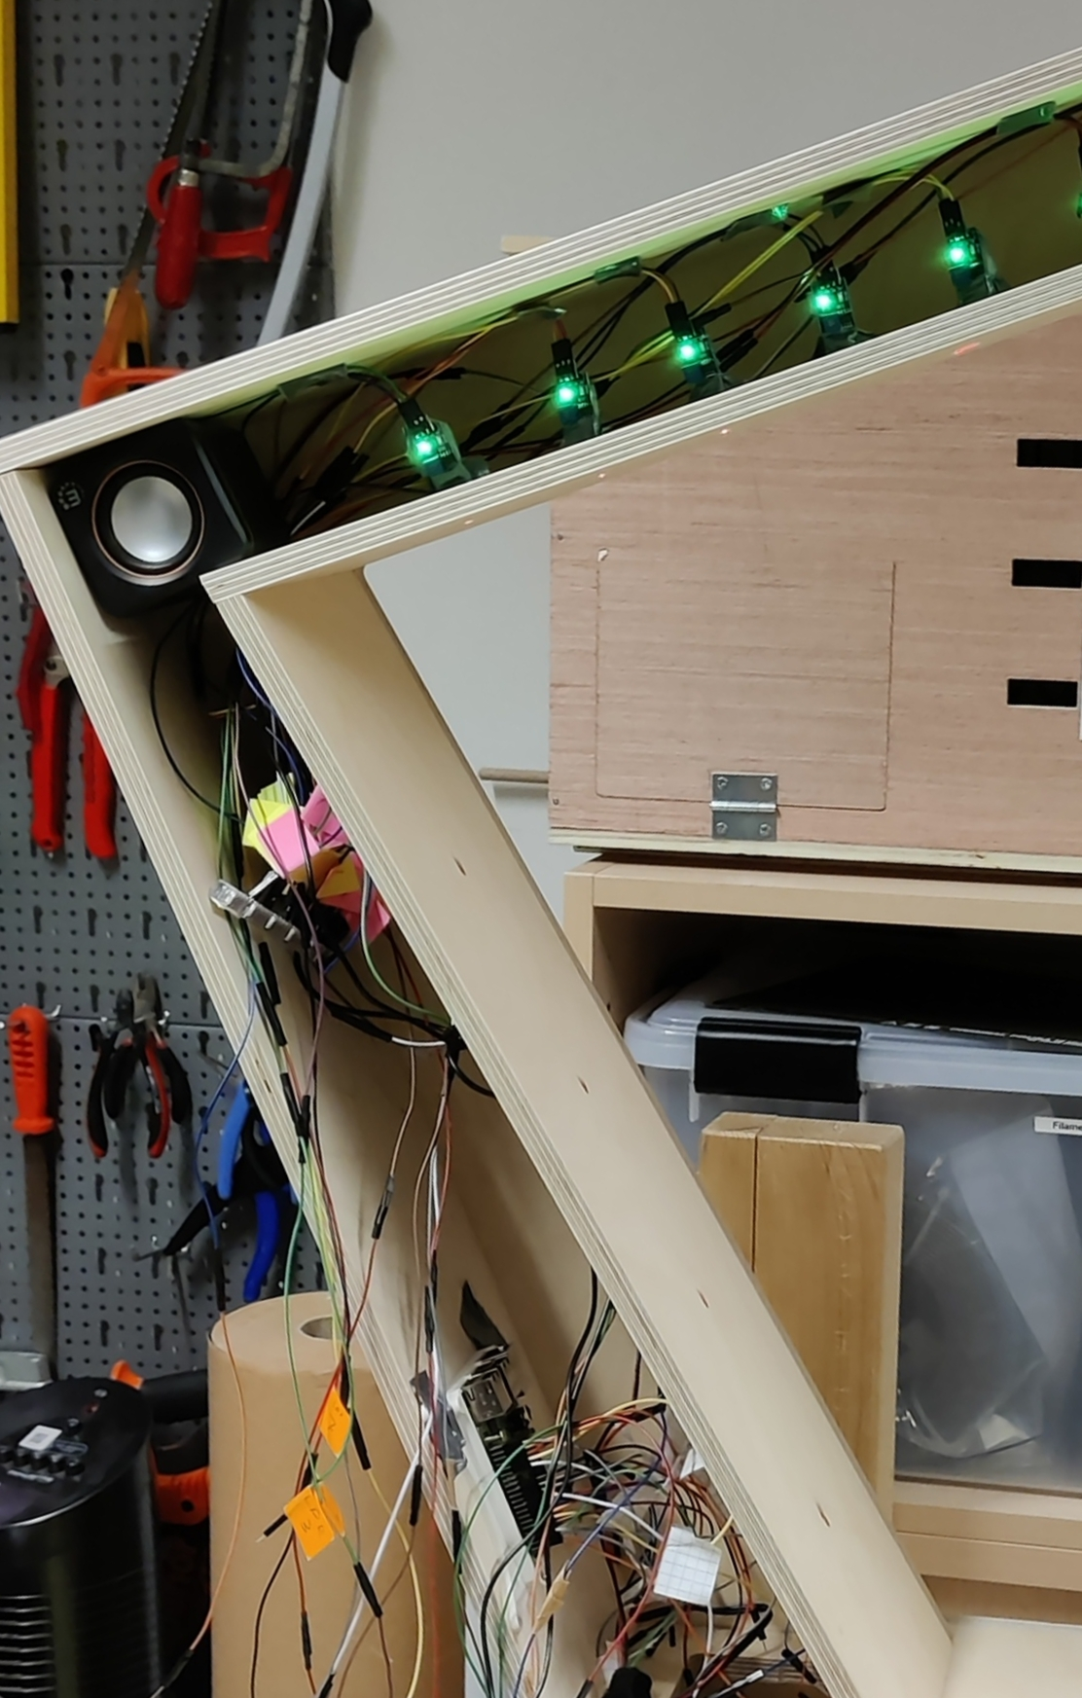
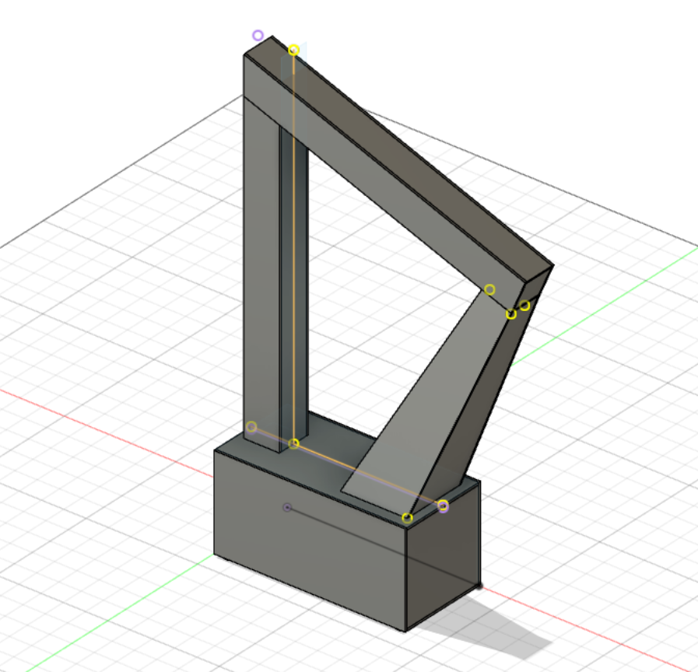
Building and Electronics

Slide 16
Group experience
Synergy of complementary skills and interests
Time management in a big group is challenging
A lot of compromises and backup options.
Good group dynamics through open communication and cooperation

Slide 17
What we learned
Electronics
Raspberry Pi Programming
Things often don't go your way (Software but especially hardware)
Always have backup plan
Whatever can go wrong will go wrong!

Slide 18
Room for improvement
Laser aiming is questionable
No flat key
Better smoke machine
Sound (better quality, no white noise, multiple samples)

Slide 19
Final Product - Video

